Slide 1


Title: Calendar Application
Subtitle: A Java Swing-based application for Event Management and Reminders
Members: Abdul Monyeem Tamzid,
University: North South University
CSE-215 Project :
Title: Calendar Application
Subtitle: A Java Swing-based application for Event Management and Reminders
Members: Abdul Monyeem Tamzid ID:2322532042,
Mehedi Hasan Dip ID:2232167042,
MD.Tamim Hasan ID:2232239642
Course Instructor: Dr.Mohammad Shifat-E-Rabbi
Section: 8
-

Slide 2

Purpose:
Develop an interactive calendar application using Java Swing.
Provide features like event management and reminders.
Highlights:
User-friendly GUI.
Persistent event storage.
Real-time notifications for events.
Slide 2: Introduction

Slide 3

Slide 3: Project Architecture
Core Components:
CalendarApplication: Main application class integrating UI and core logic.
CalendarManager: Manages event storage and retrieval.
Event: Represents individual calendar events.
ReminderService: Schedules and displays reminders.
Utility: Provides utility methods for date-time parsing.

Slide 4
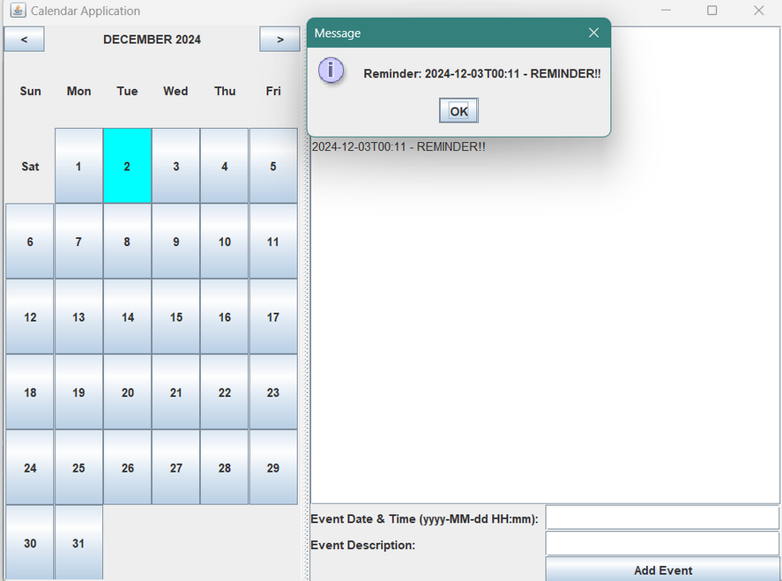
Slide 4: Features
Calendar Display:
Monthly view with navigation.
Highlights current date.
Event Management:
Add events with date, time, and description.
Persist events to a file for future sessions.
Reminders:
Real-time notifications for upcoming events.

Slide 5
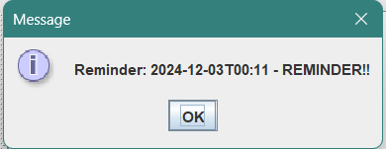
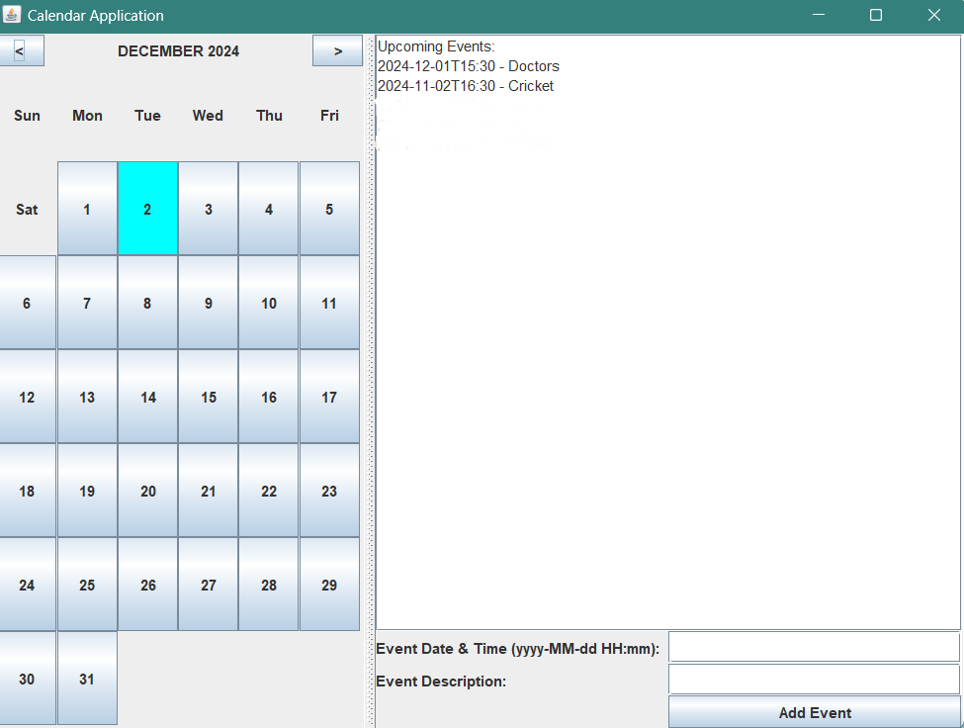
Slide 5: User Interface
Main Components:
Calendar panel with navigation buttons.
Input fields for event creation.
Event display area.
Technology:
Developed using Java Swing.
Responsive and intuitive layout.

Slide 6
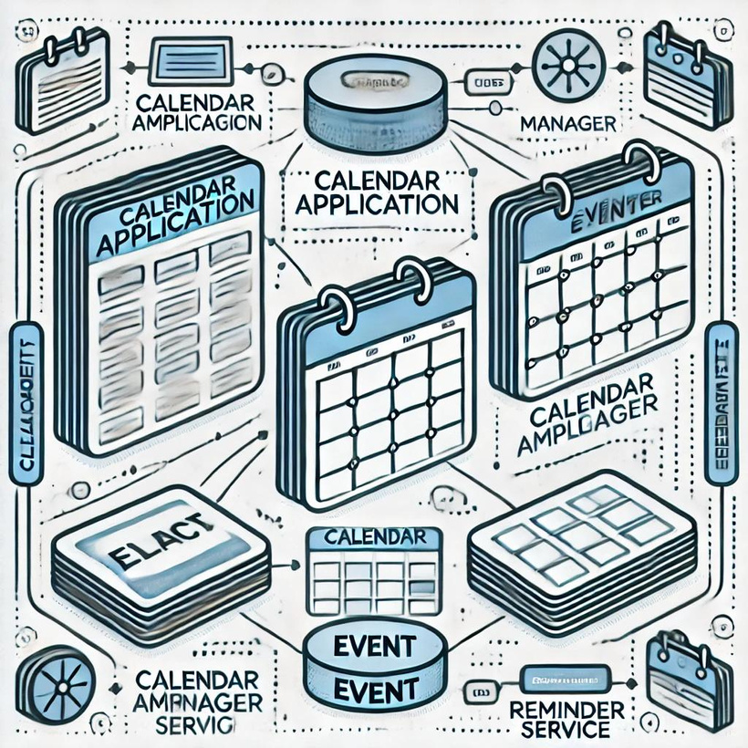
Slide 6: Class Diagram
Diagram showing relationships between classes:
CalendarApplication connects CalendarManager and ReminderService.
Event used by CalendarManager and ReminderService.
Utility for shared methods.

Slide 7

Slide 7: Challenges and Solutions
Challenge: Handling invalid date-time inputs.
Solution: Added robust error handling using try-catch blocks.
Challenge: Persistent storage for events.
Solution: Implemented file-based read/write operations in CalendarManager.
Challenge: Ensuring reminders are accurate.
Solution: Used ScheduledExecutorService for real-time scheduling.

Slide 8

Slide 8: Conclusion
Summary:
Successfully built a feature-rich calendar application.
Learned about GUI development, file handling, and real-time scheduling in Java.
Thank You!
Questions and feedback are welcome.

Slide 9
Thank You
-

